Slide 1

American Rescue Plan Act (ARPA)
Update
July 10, 2023

Slide 2
ARPA Overview
ARPA Refresh
Budget Update (Restricted and Unrestricted)
ARPA Projects Overview
Leveraging/Grants

Slide 3
ARPA Refresh
The City of Rock Island received $26.5 million in ARPA funding.
Restricted vs. Unrestricted (revenue replacement)
Roads are not considered eligible under U.S. Treasury guidelines.
In June 2022, the City Council adopted 5 ARPA Guiding Principles.
In July 2022, the City of Rock Island initiated an ARPA survey.

Slide 4
ARPA Budget Restricted Funds
Project | Dept | Total | ACTUAL | Remaining $ as 7/5/23 | Project Status
ARPA Program Manager (includes fringe benefits and pension) | General Admin | $ 238,575.62 | $ 238,575.62 | N/A | In progress (ends 12/31/24)
Communication Specialist (includes fringe benefits and pension) | General Admin | $ 209,098.33 | $ 209,098.33 | N/A | In progress (ends 12/31/24)
Downtown RI Project | City-wide | $ 2,500,000.00 | $ 2,500,000.00 | 2,500,000.00 | Engineering and Design Started
ARPA Survey expenses and other materials | General Admin | $7,751.70 | $7,751.70 | - | Complete
Augustana Slough Sewer Replacement | Public Works | $ 400,000.00 | $ 400,000.00 | 400,000.00 | Not Started
Broadband Fiber Optic Infrastructure Expansion | IT | $ 300,000.00 | $ 300,000.00 | 300,000.00 | Started
Hauberg Estate Carriage House | Parks | $ 250,000.00 | $ 254,967.47 | - | Complete
Advanced Metering Infrastructure | Public Works | $ 1,500,000.00 | $ 1,500,000.00 | 1,500,000.00 | In progress
Watts/Midtown Library | Library | $ 500,000.00 | $ 500,000.00 | - | Complete
Fleet Replacement (Fire ambulances) | Public Works | $ 891,590.18 | 869,199.00 | - | Complete
Denkmann Park Basketball Resurfacing | Parks | $ 100,000.00 | $ 104,967.47 | - | Complete
STEAM Lab | MLK | $ 100,000.00 | $ 100,000.00 | 100,000.00 | Not Started
Replace Weather Sirens | Fire | $ 58,000.00 | 58,771.00 | - | Complete
Mill Street Anaerobic Digester Rehab | Public Works | $ 1,400,000.00 | $ 1,400,000.00 | 1,400,000.00 | No Started
Video Recording System | IT | $ 45,000.00 | $ 45,000.00 |  | Not Started
SW Treatment Plant Influent Pump Station | Public Works | $ 2,650,000.00 | 2,650,000.00 | 2,492,188.31 | In progress
Backup Generators - water treatment plant | Public Works | $ 500,000.00 | $ 500,000 | 500,000.00 | N/A
Station Alerting System - New P25 | Fire | $ 200,000.00 | $ 200,000.00 | 200,000.00 | No Started
West End Initiative - Revitalization | MLK | $ 50,000.00 | $ 100,000.00 | 96,956.95 | In progress
City Camera Network System | Police | $ 250,000.00 | $ 250,000.00 | 243,147.17 | In progress
Emergency Services Radio | Police | $ 1,072,000.00 | $ 1,072,000.00 | 1,072,000.00 | Not Started
Housing Rehabilitation | CED | $ 250,000.00 | $ 250,000.00 | 140,287.00 | In progress - Land Bank Complete
Extrication Equipment | Fire | $ 112,000.00 | $ 107,495.87 | - | Complete
Mel McKay Pickleball Courts | Parks | $ 300,000.00 | $ 300,000.00 | 300,000.00 | Not Started
License Plate Reader Lease/Shot spotter - 3 years | Police | $ 225,000.00 | $ 225,000.00 | 173,000.00 | In progress
Public Safety - 3 years | General Admin | $ 300,000.00 | $ 300,000.00 | 300,000.00 | Not Started
Police Hiring/ Retention/ Recruitment | Police | $ 250,000.00 | $ 250,000.00 | 177,000.00 | In progress
RIFAC Repairs | Parks | $ 750,000.00 | $ 750,000.00 | 721,350.00 | In progress (engineering complete)
Highland Springs Clubhouse | Parks | $ 600,000.00 | $ 600,000.00 | - | Complete
Demolitions | CED | $ 250,000.00 | $ 250,000.00 | 250,000.00 | Not Started
Douglas Park Lighting | Parks | $ 200,000.00 | $ 196,924.00 | 3,076.00 | Complete
TOTAL: |  | $ 16,459,015.83 | $16,489,750

Slide 5
ARPA Unrestricted Funds
Project | Dept | Requested $ | Remaining $ | Project Status
City Software | City-wide | $ 2,250,000.00 | $ 2,214,291.00 | In progress (anticipated completion 2025)
Rock Island Parkway | Public Works | $ 333,709.84 | $ - | Complete
Parking Garage | Public Works | $ 1,200,000.00 | $ 110,931.46 | Complete (invoices still pending)
Fleet | Public Works | $ 608,409.82 | $ - | Complete (on order)
Sunset Marina | Public Works | $ 1,000,000.00 | $ 690,700.00 | In progress
Road Repairs | Public Works | $ 1,000,000.00 | $ 1,000,000.00 | Not started
Assistance to Businesses | General Admin/CED | $ 750,000.00 | $ 750,000.00 | In progress
Infill Housing and New Housing Incentives | CED/General Admin | $ 500,000.00 | $ 500,000.00 | Not started
City - Lost Revenue | Finance/ General Admin | $ 1,000,000.00 | $ 383,000.00 | In progress (tourism entities, West End, Employee bonuses)
Mental Health | General Admin | $ 250,000.00 | $ 250,000.00 | Not started
Aid to Tourism | General Admin | $ 250,000.00 | $ 250,000.00 | Not started
Homelessness | General Admin | $ 250,000.00 | $ 250,000.00 | No started
City Hall Renovations | General Admin | $ - | $ - | Recommended
Façade Improvement Program | CED | $ 500,000.00 | $ 450,000.00 | In progress
TOTAL: $9,892,119.66

Slide 6
ARPA Dashboard

Slide 7
ARPA DASHBOARD

Slide 8
ARPA Dashboard
Infrastructure Category (No. 1 on Survey) | Amount
City Software (unrestricted) | $ 2,250,000.00
Rock Island Parkway (unrestricted) | $ 333,709.84
Parking Garage (unrestricted) | $ 1,200,000.00
Road Repairs (unrestricted) | $ 1,000,000.00
Downtown RI Project (restricted) | $ 2,500,000.00
Augustana Slough Sewer Replacement (restricted) | $ 400,000.00
Broadband Fiber Optic Infrastructure Expansion (restricted) | $ 300,000.00
Advanced Metering Infrastructure (restricted) | $ 1,500,000.00
Mill Street Anaerobic Digester Rehab (restricted) | $ 1,400,000.00
SW Treatment Plant Influent Pump Station (restricted) | $ 2,650,000.00
Backup Generators - water treatment plant (restricted) (possible grant) | $ 500,000.00
Total: | $ 14,033,709.84

Slide 9
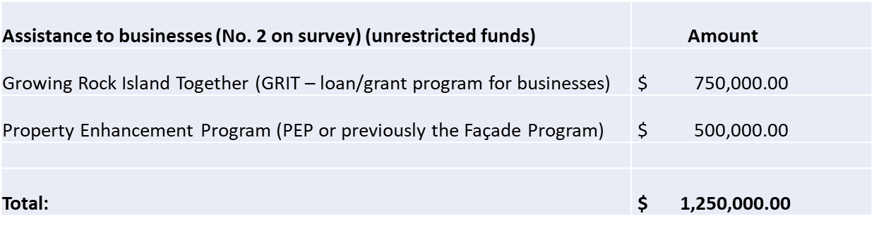
ARPA Dashboard

Slide 10
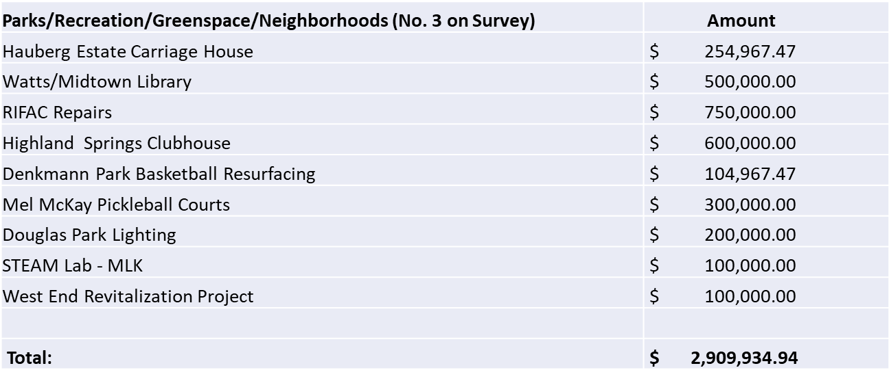
ARPA Dashboard

Slide 11
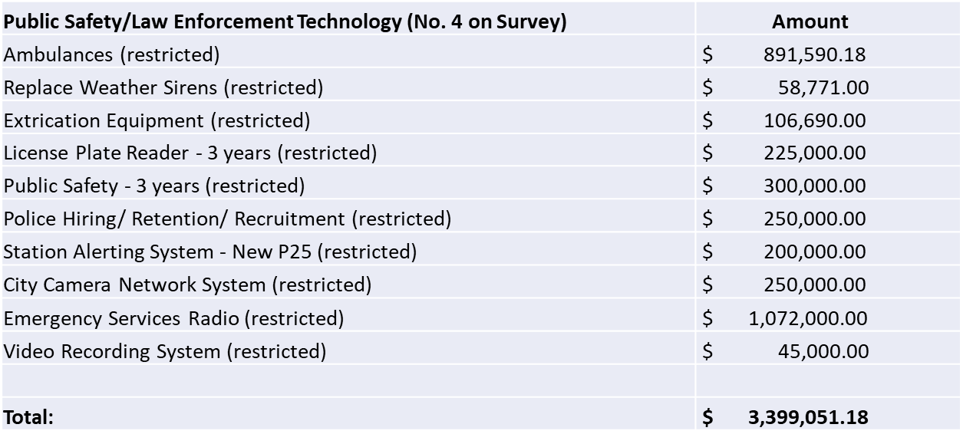
ARPA Dashboard

Slide 12
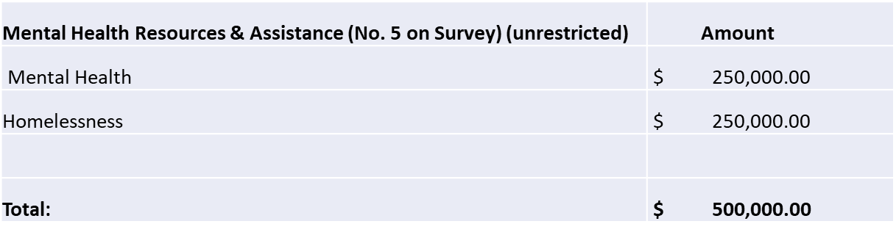
ARPA Dashboard

Slide 13
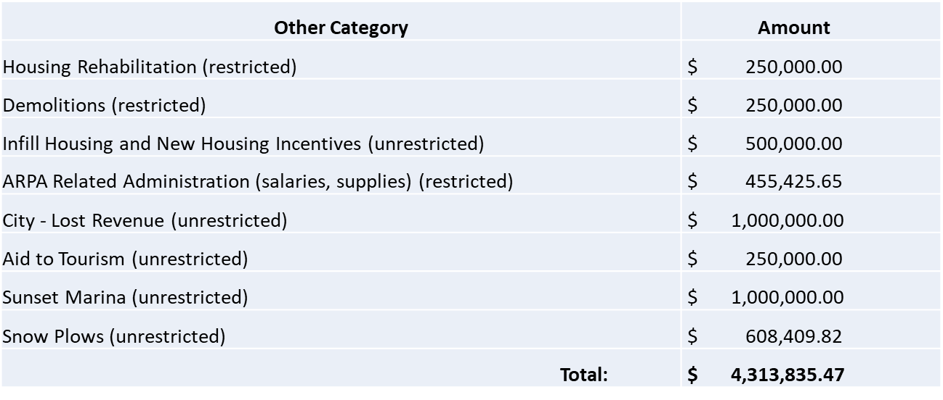
ARPA Dashboard

Slide 14
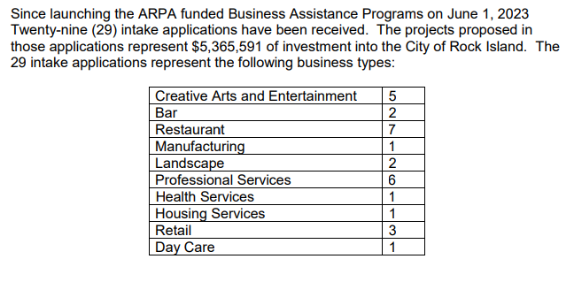
ARPA Project Updates
Assistance to Businesses – Grow Rock Island Together (GRIT) Program and Property Enhancement Program (PEP)

Slide 15
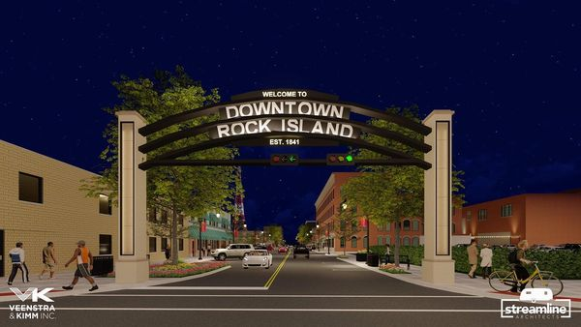
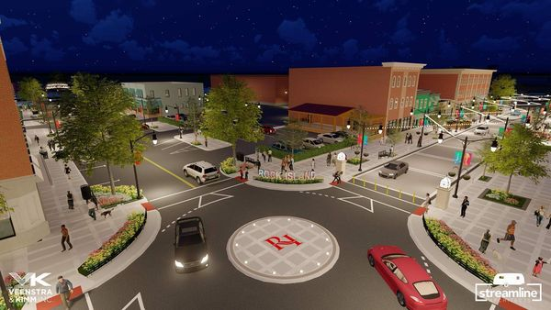
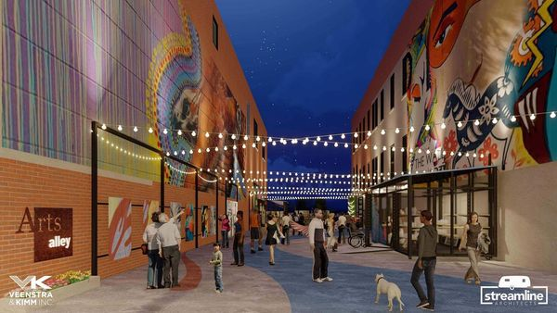
ARPA Project Updates
Infrastructure Projects – Downtown Rock Island (restricted funds)
Take the Survey!
https://forms.gle/JvHytrRSShHA9VYk8

Slide 16
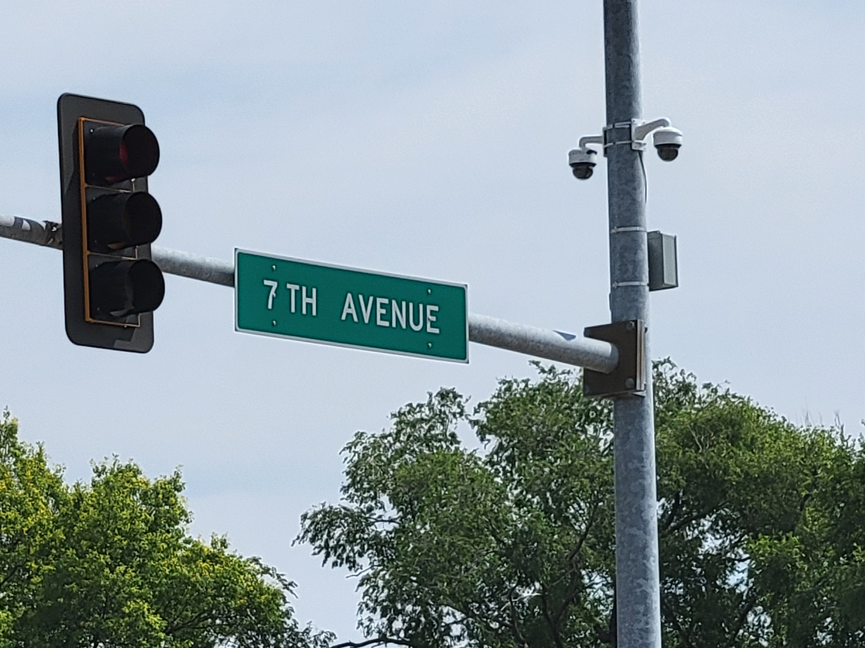
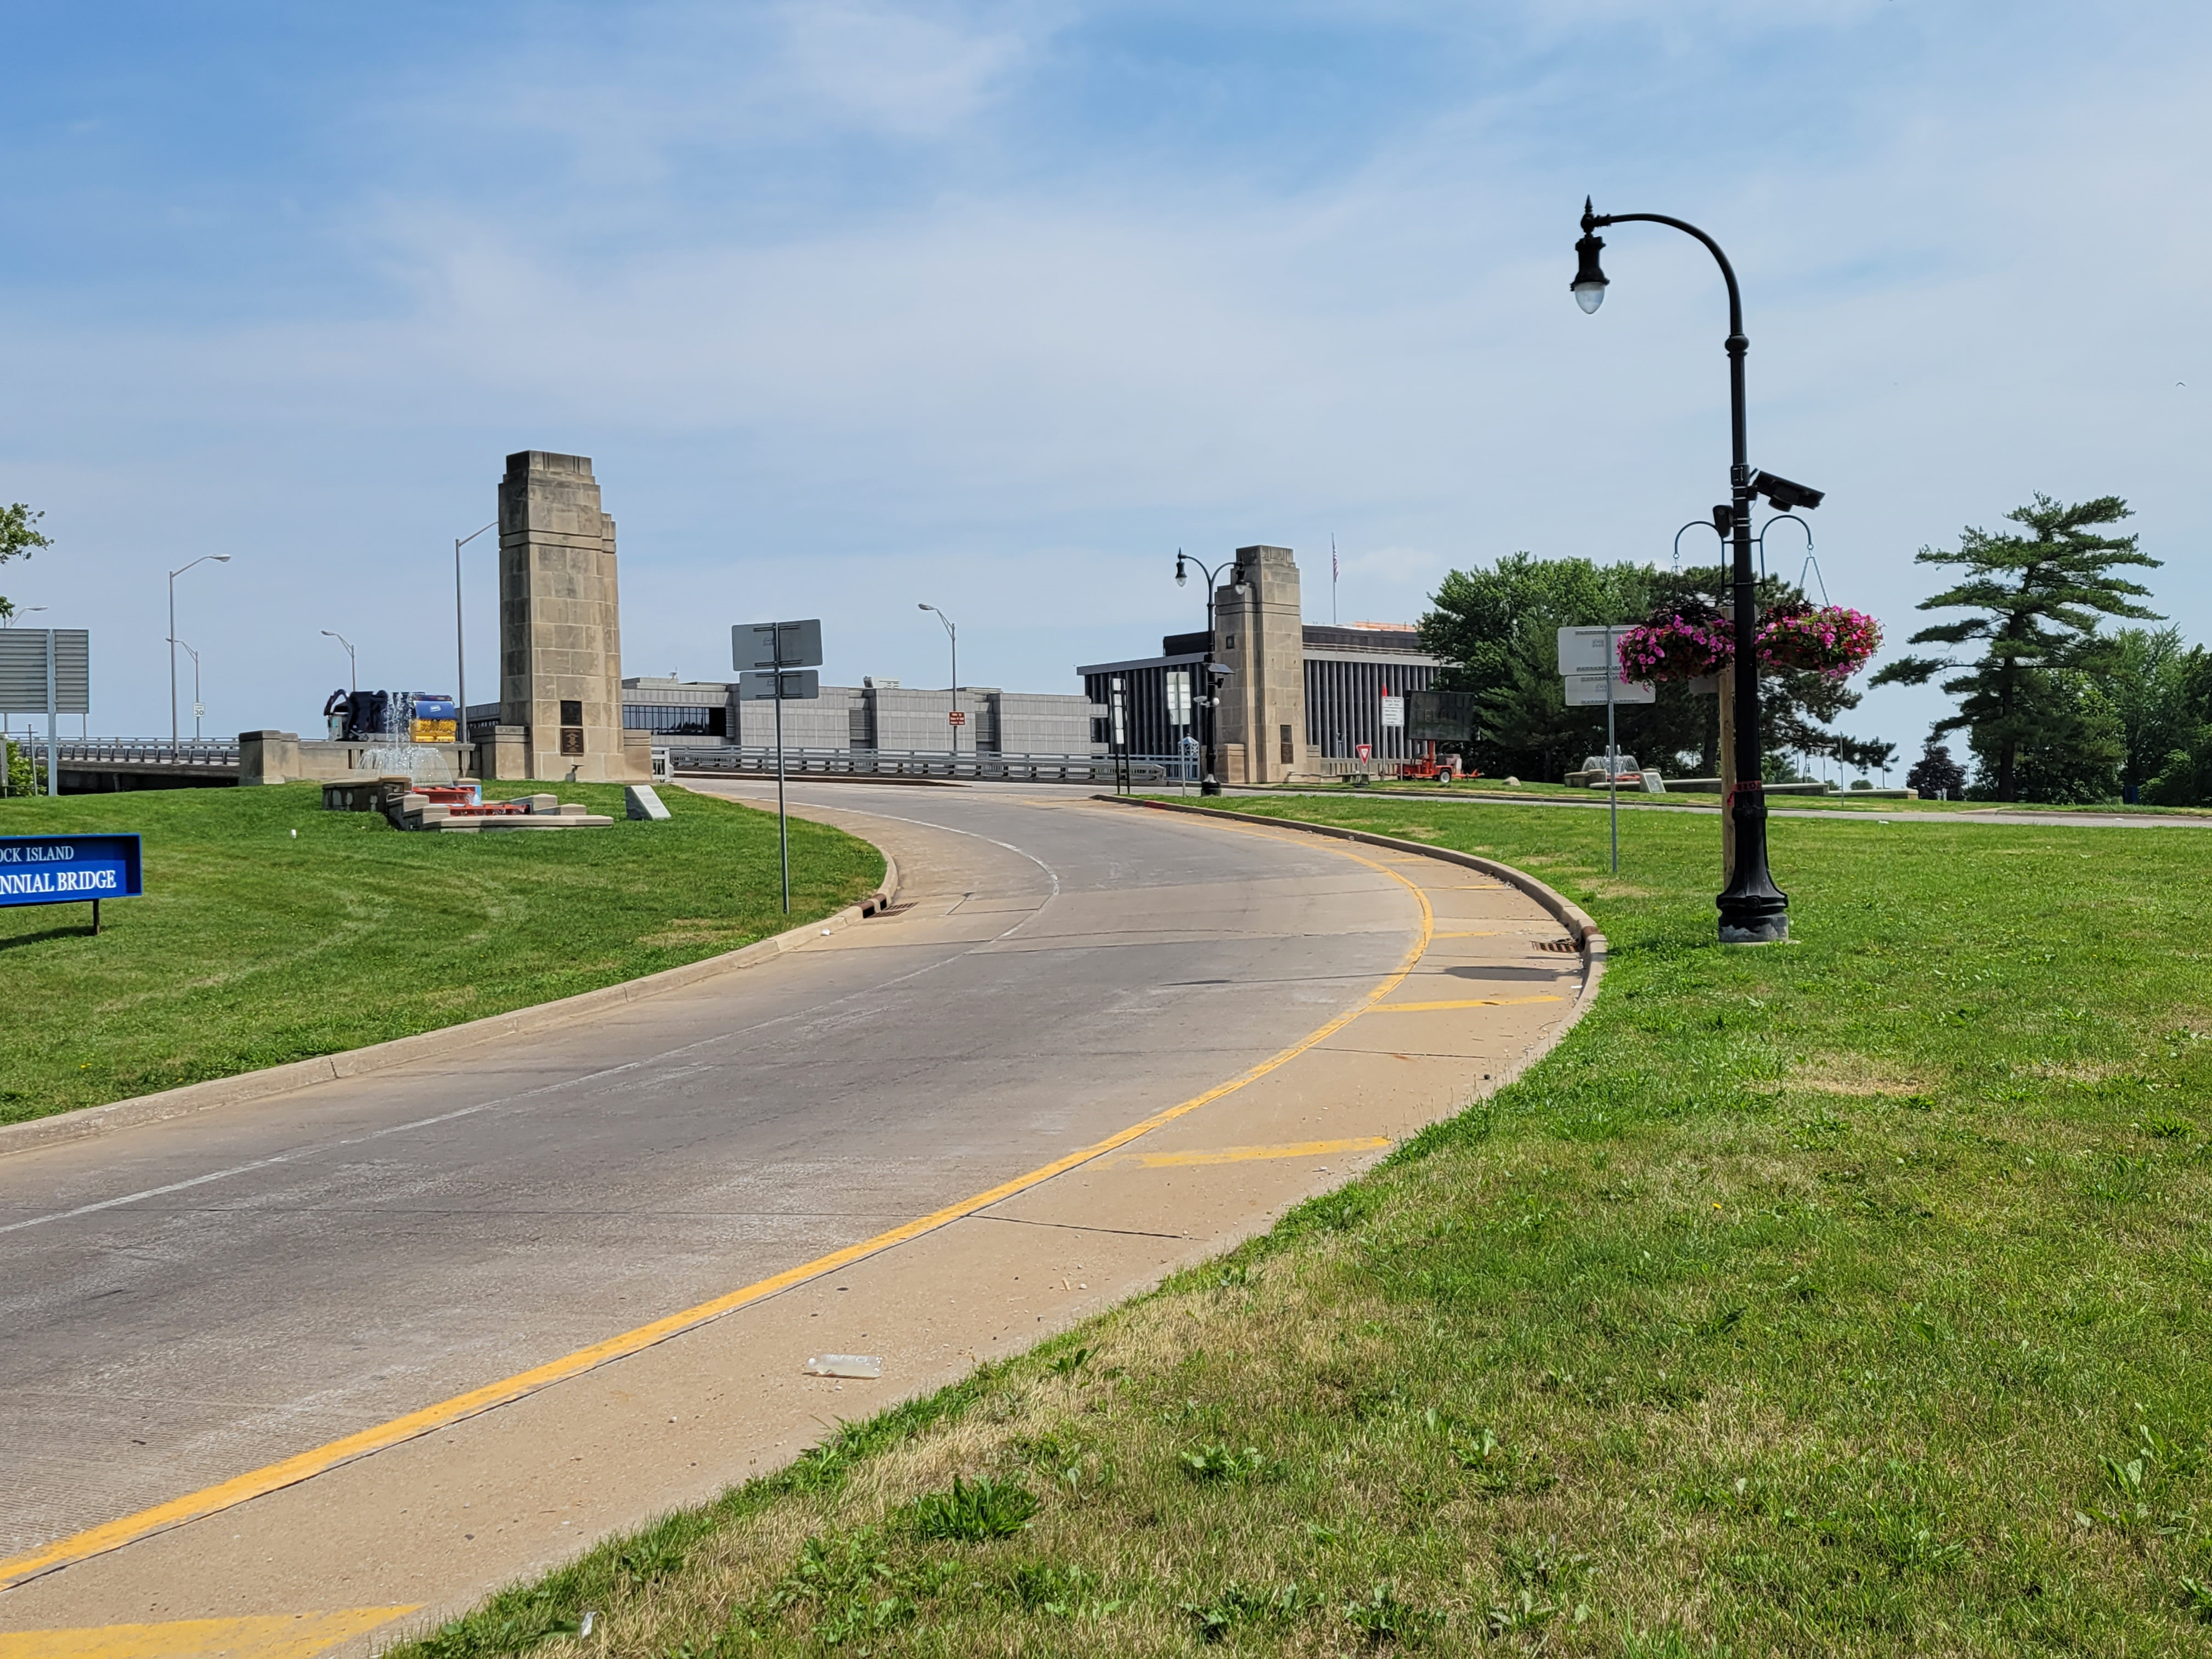
ARPA Project Updates
Public Safety/Law Enforcement Technology – City Camera Network Expansion and License Plate Readers (restricted funds)

Slide 17
ARPA Focus Group Updates
Focus Groups (fall 2022)
Mental Health
Follow-up with Ald. Hurt forthcoming
Homelessness
Follow-up with Ald. Swanson forthcoming
Tourism
Ald. Gilbert and Parker, City Manager and ARPA Manager met with Visit Quad Cities (RFP)
Waiting for new Economic Development Director before proceeding further

Slide 18
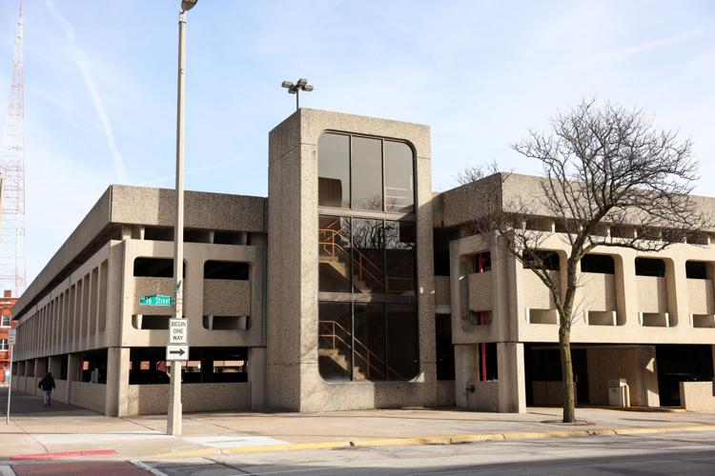
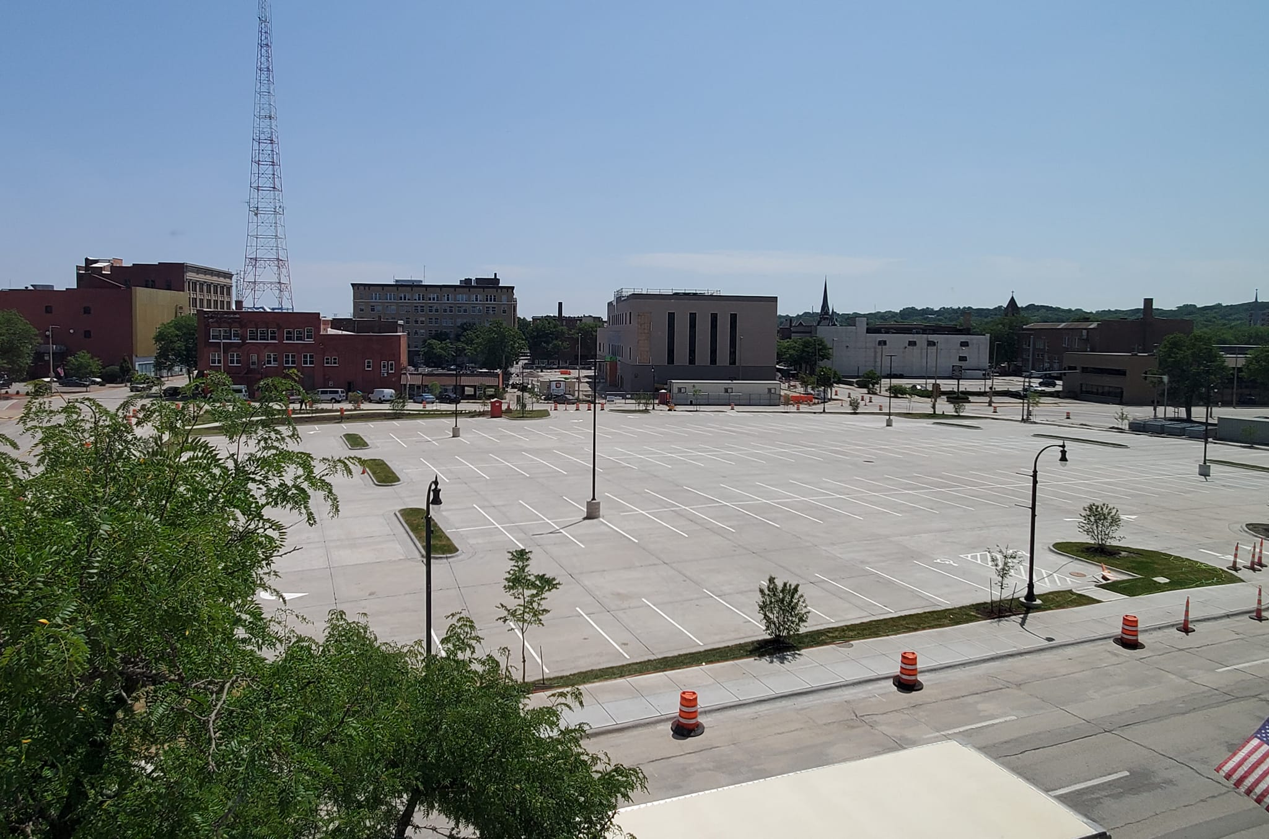
ARPA Completed Projects
Infrastructure Projects – Downtown Parking Garage (unrestricted funds)

Slide 19
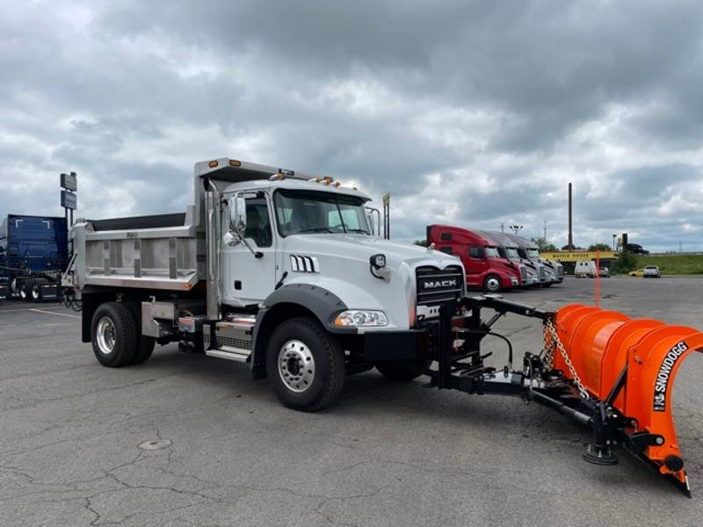
ARPA Completed Projects
Infrastructure Projects – Snow Plows (unrestricted funds)

Slide 20
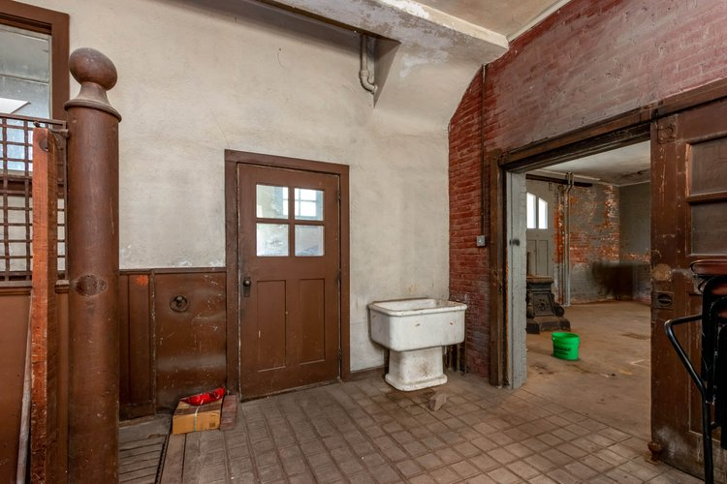
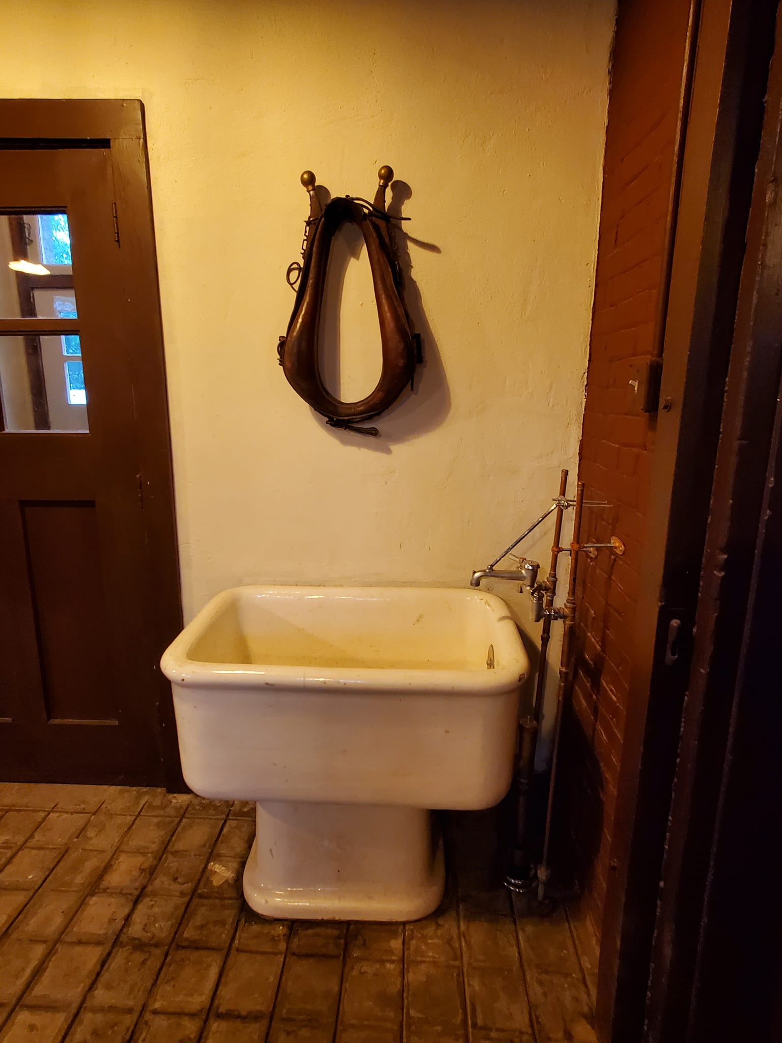
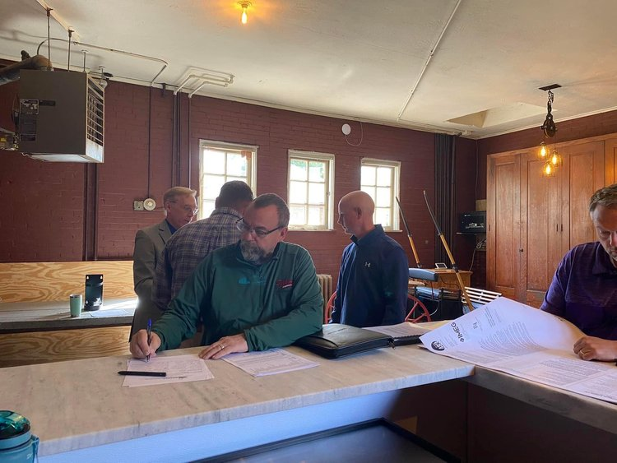
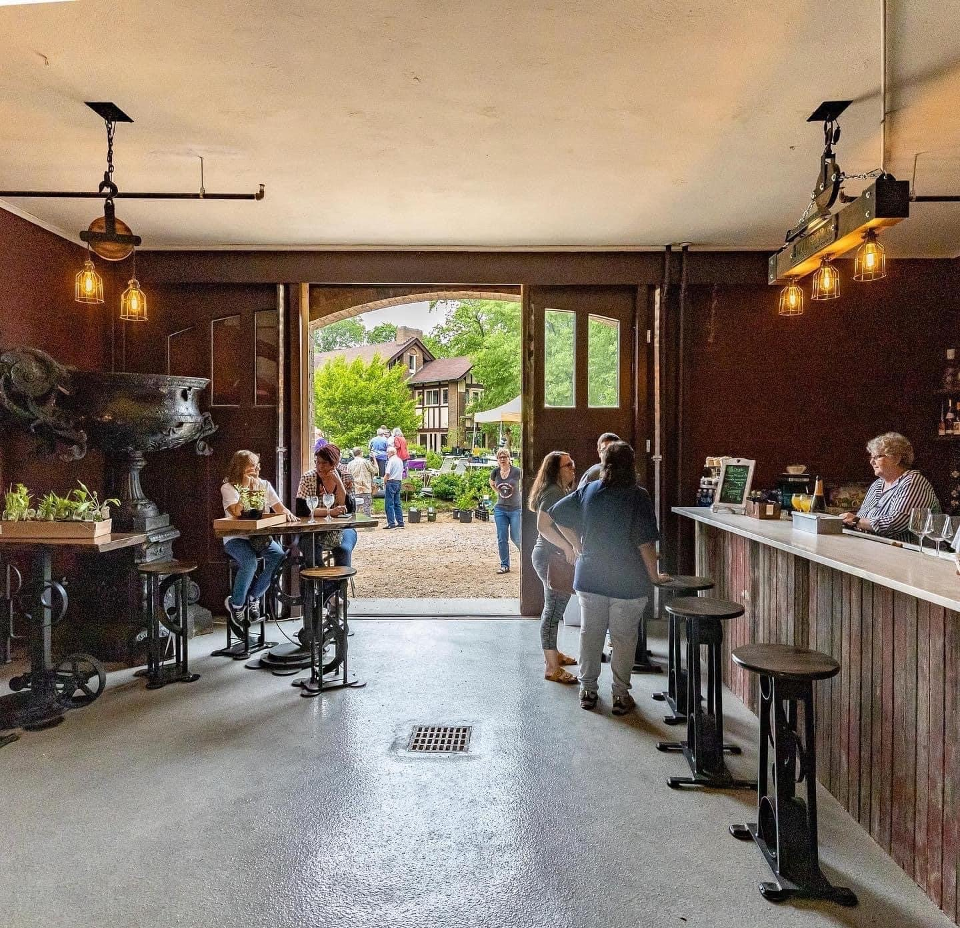
ARPA Completed Projects
Parks/Recreation/Greenspace/Neighborhoods: Hauberg Estate Carriage House – ARPA restricted funds
After

Slide 21
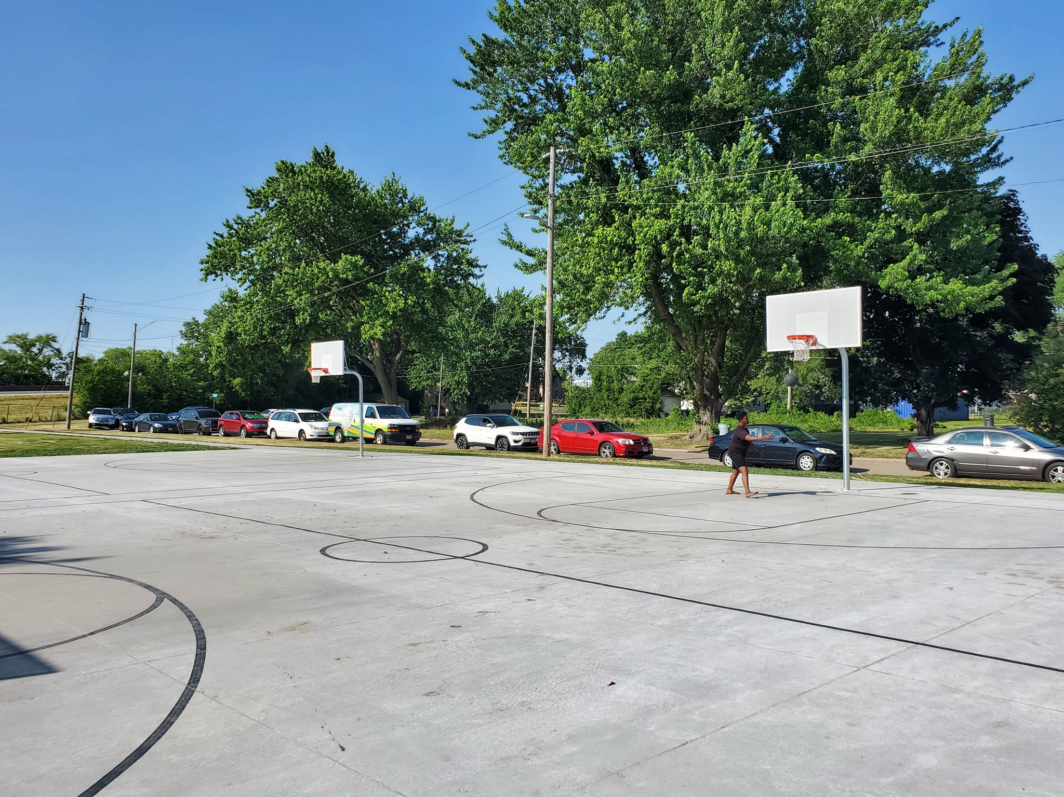
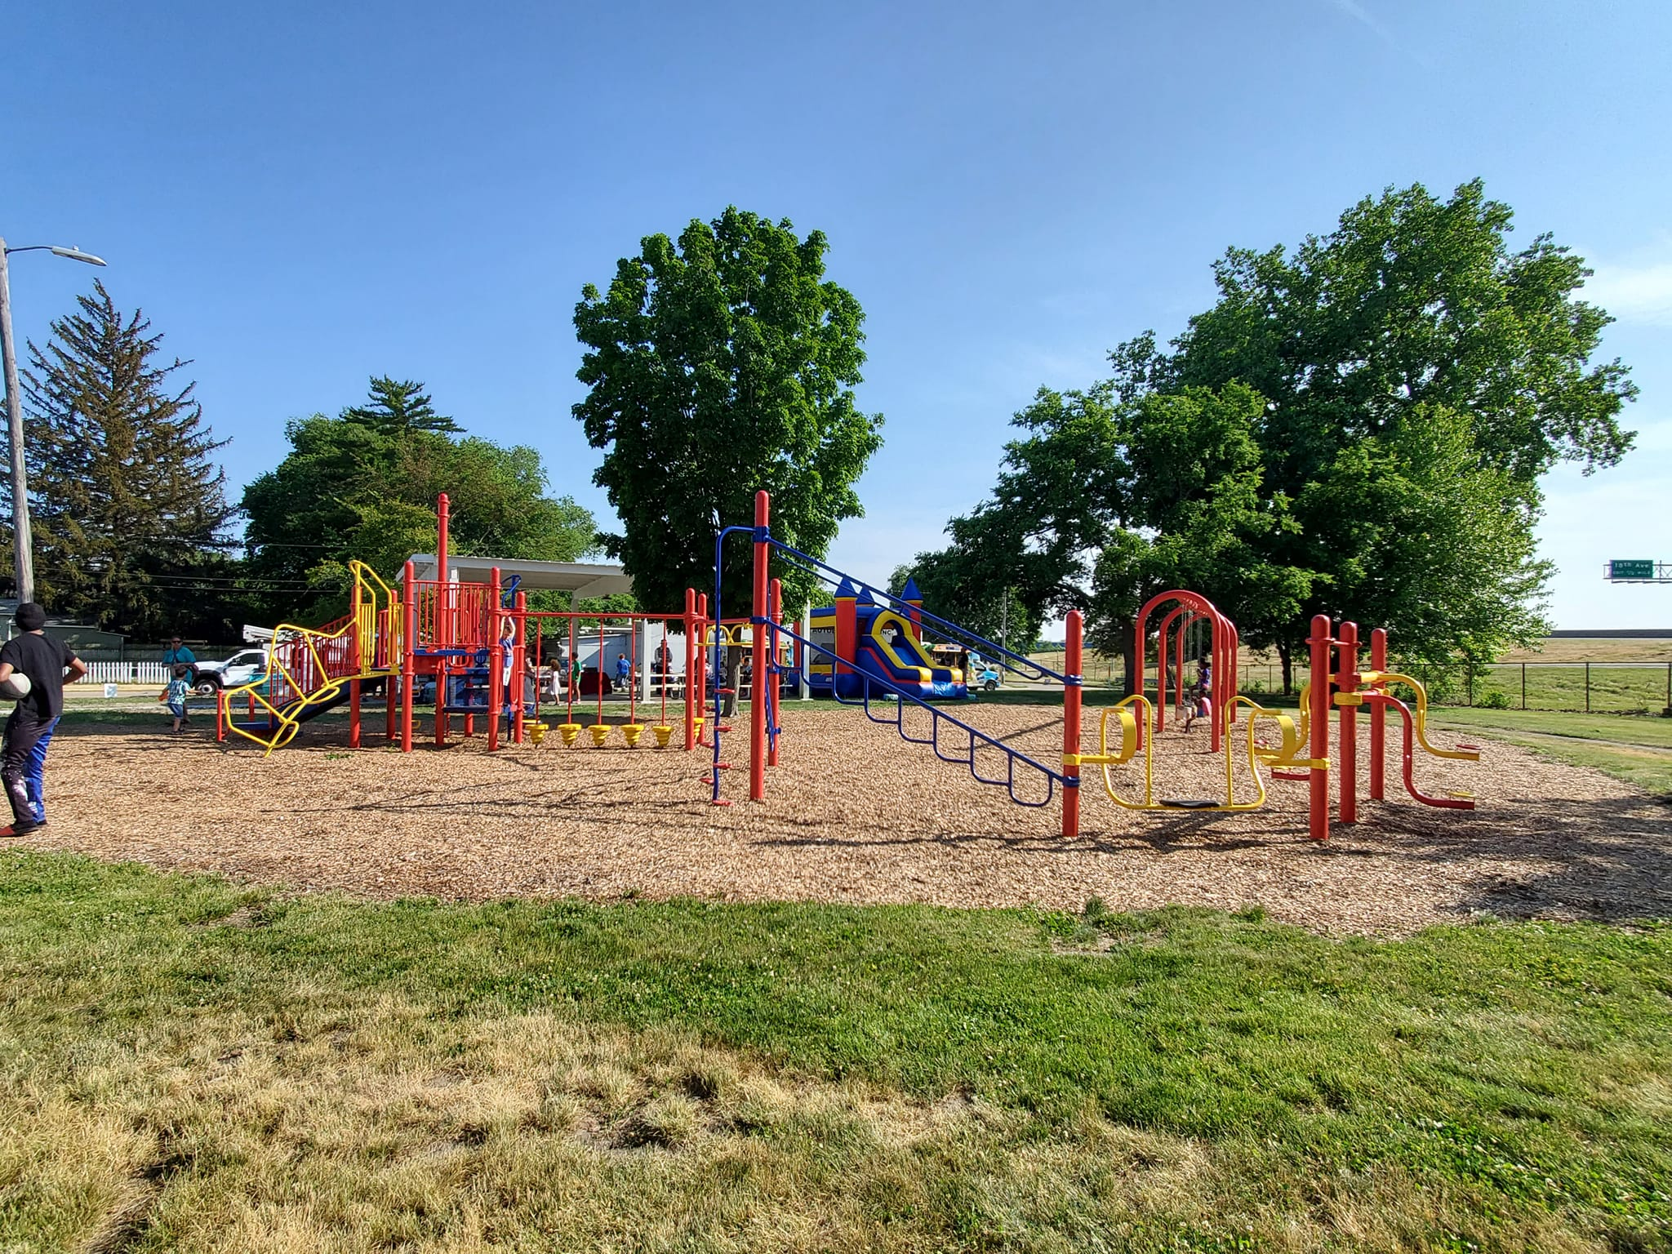
ARPA Completed Projects
Parks/Recreation/Greenspace/Neighborhoods: Denkmann Park – ARPA restricted funds

Slide 22
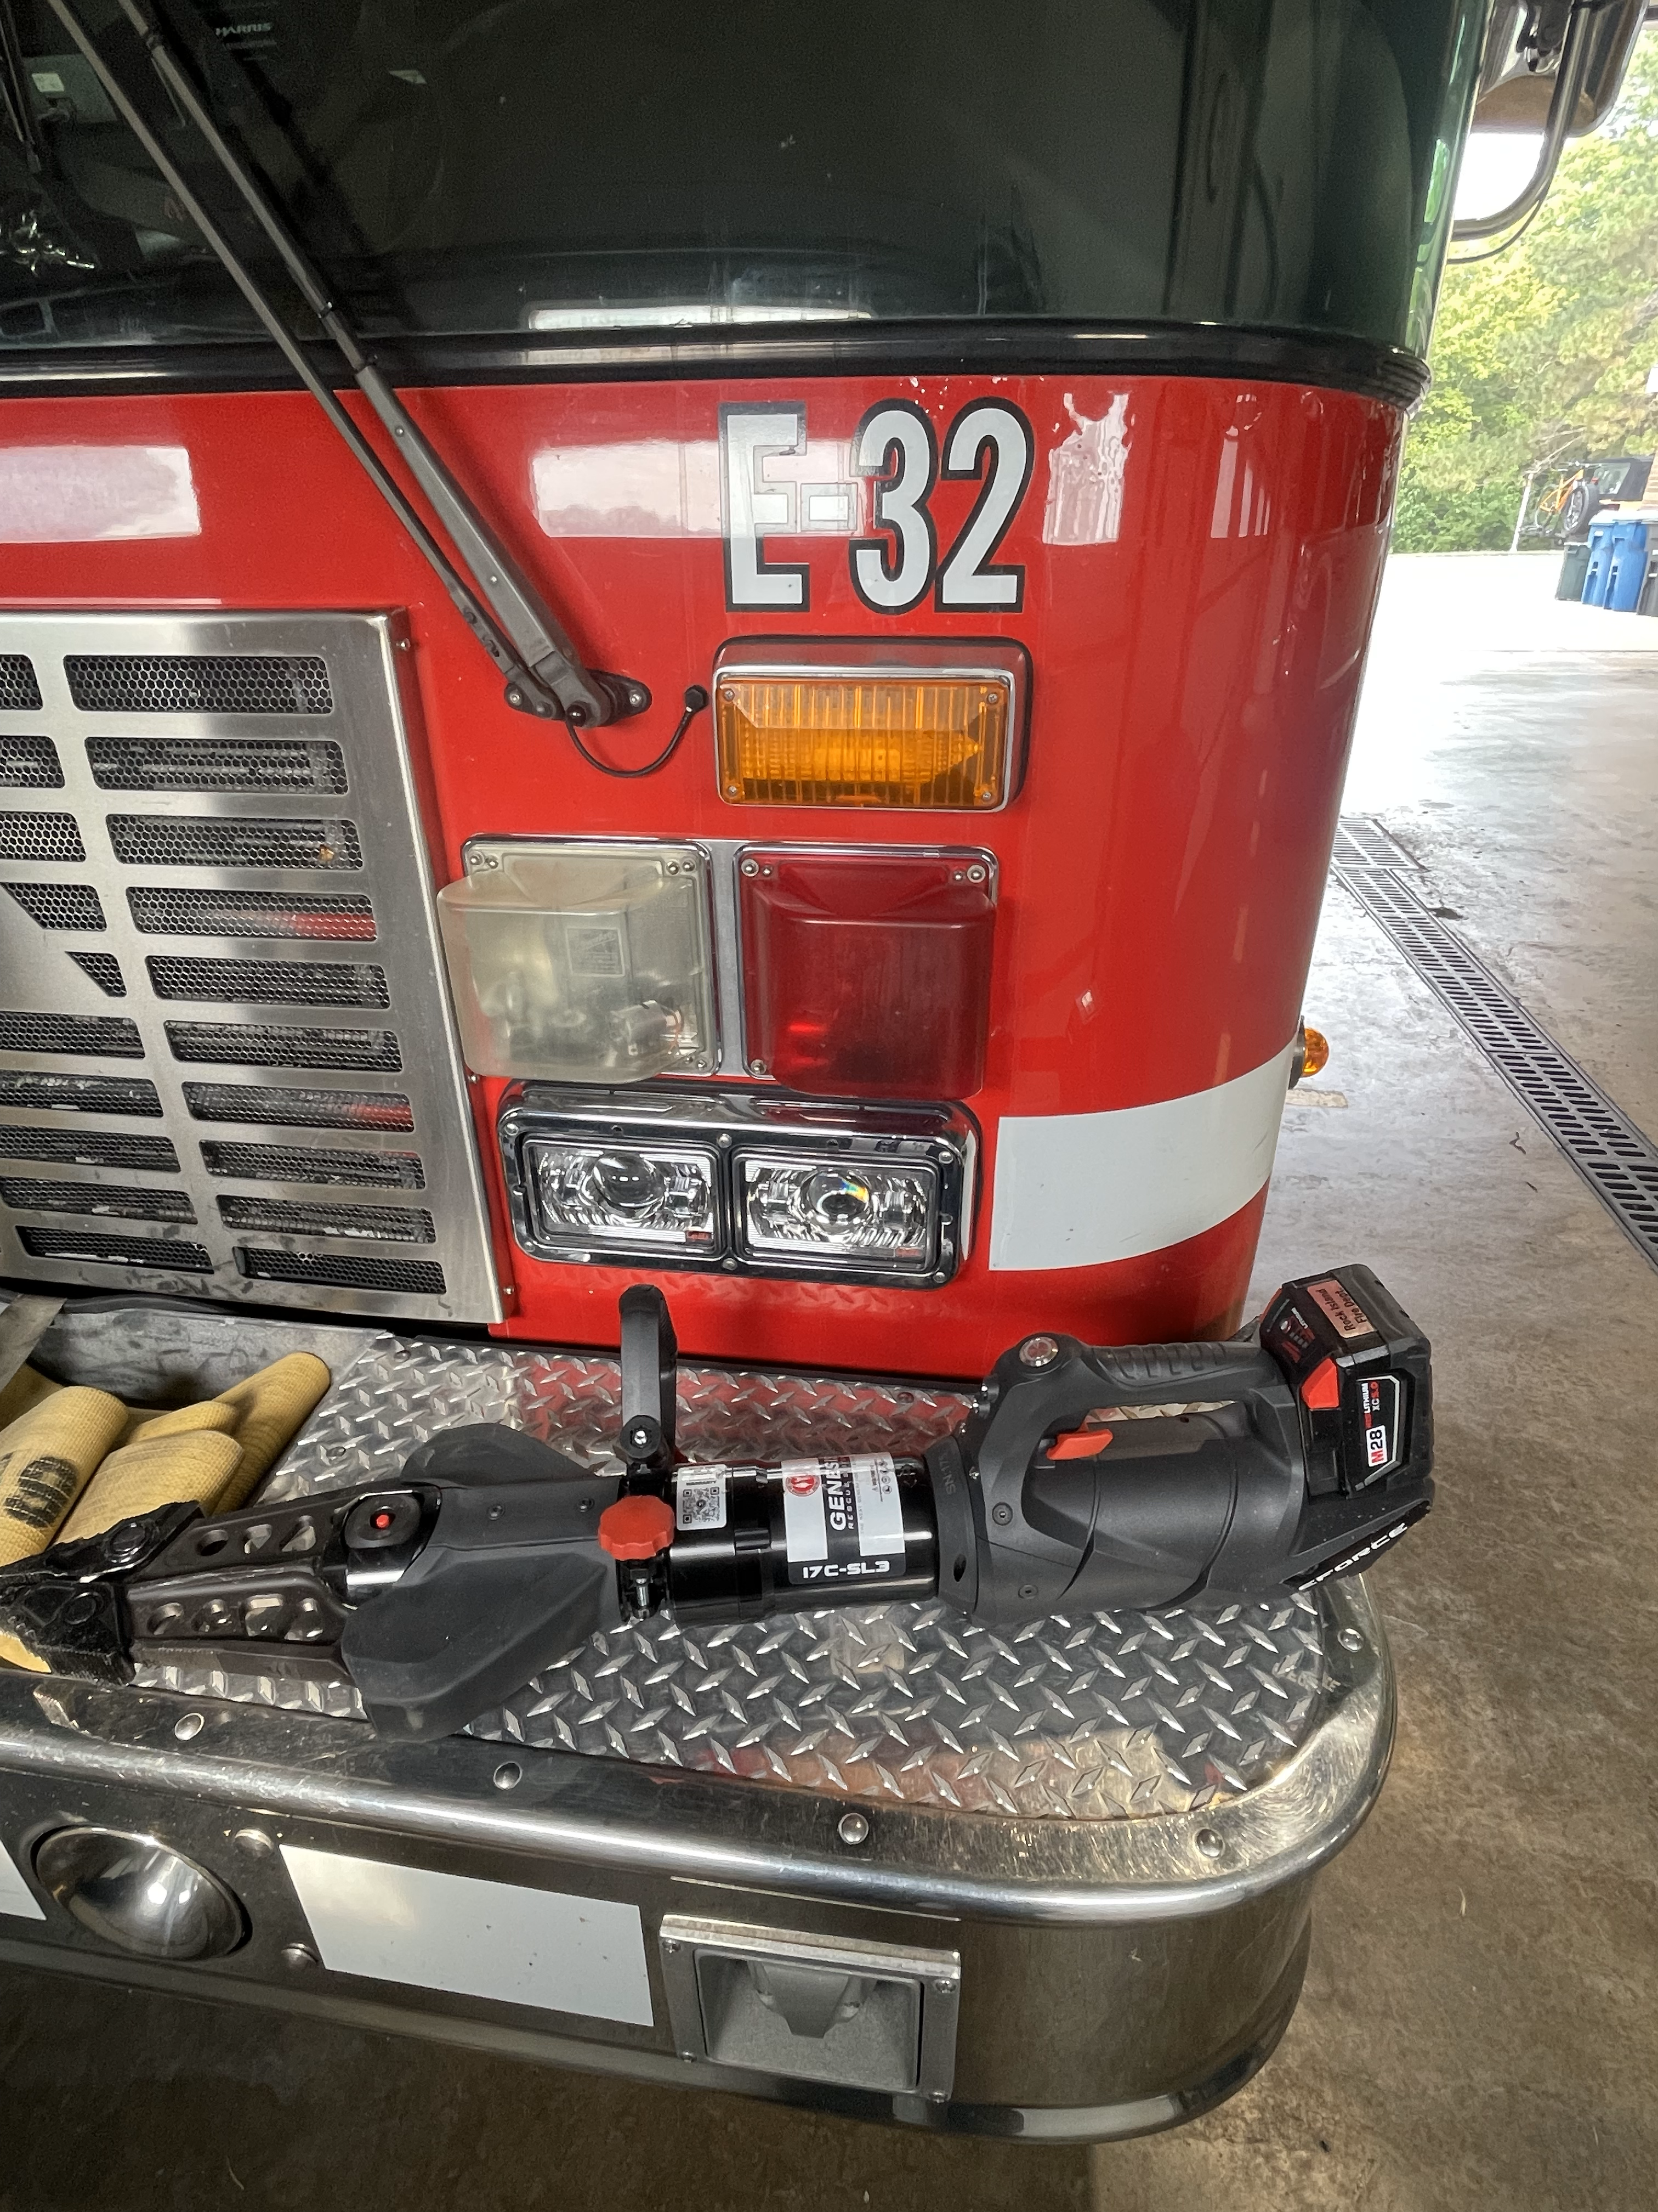
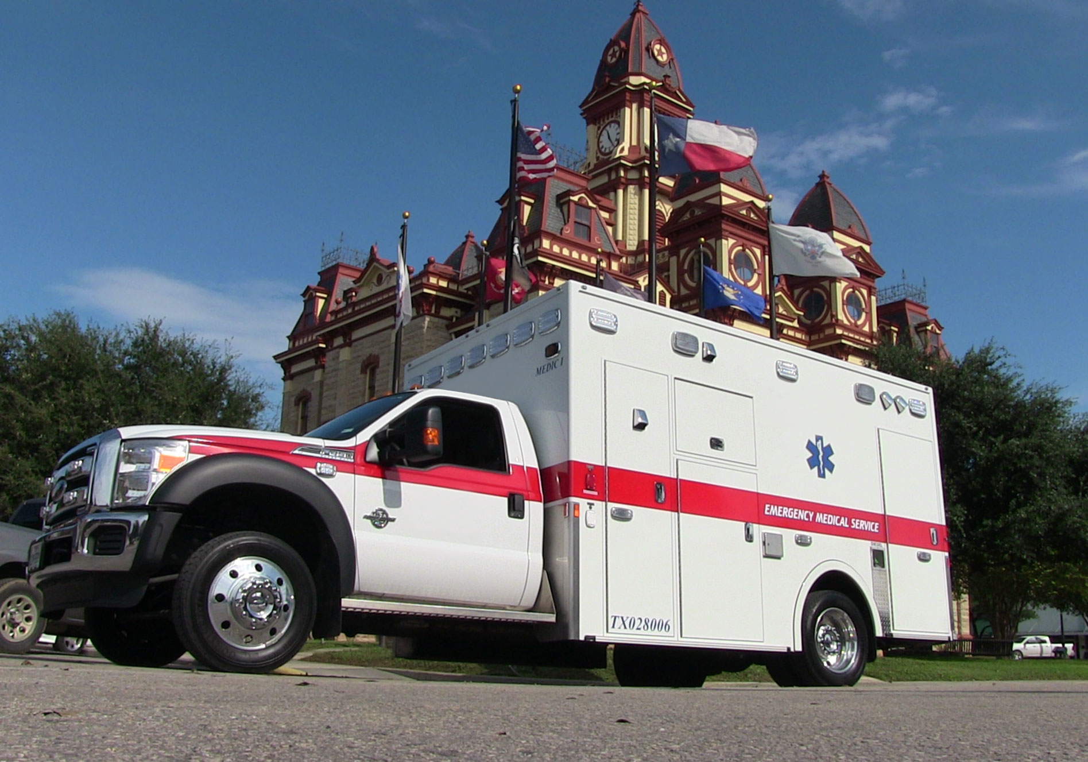
ARPA Completed Projects
Public Safety: Ambulances and Extrication Equipment (restricted funds)

Slide 23
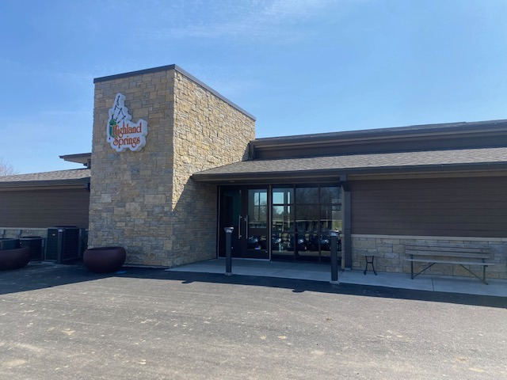
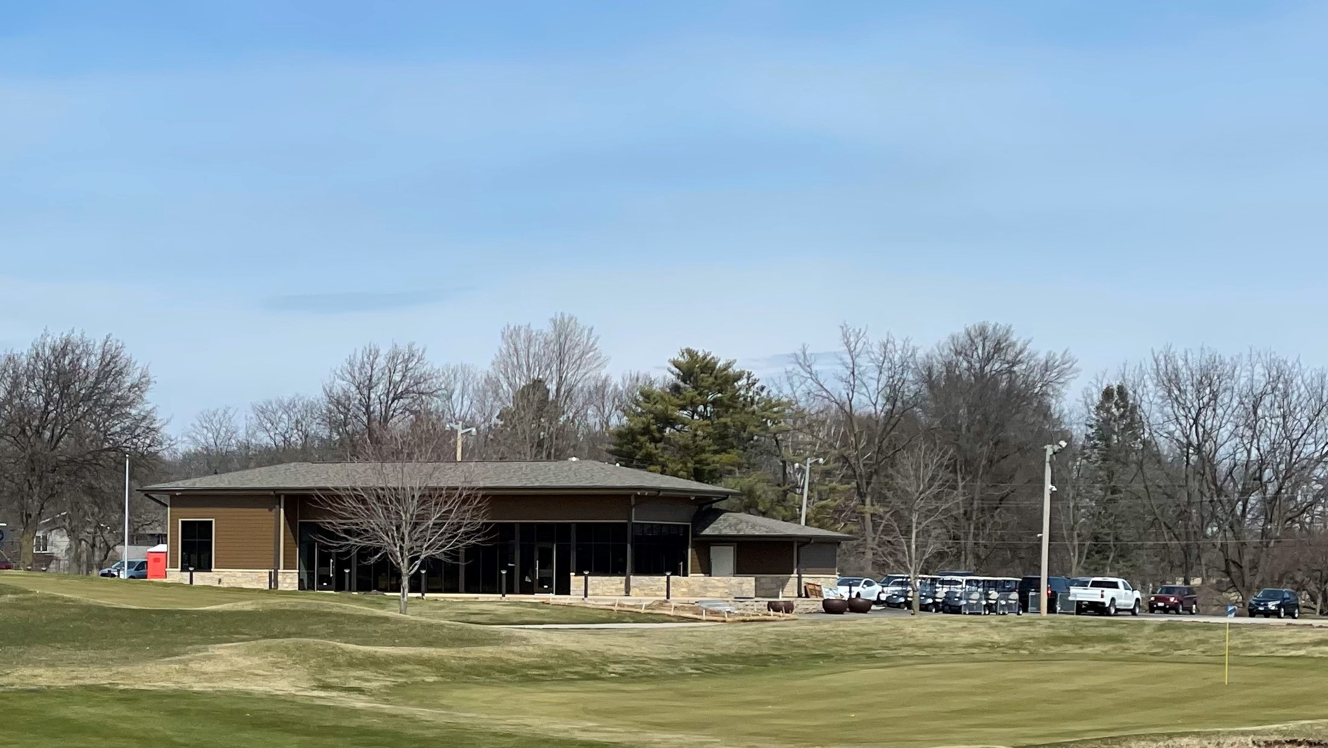
ARPA Completed Projects
Parks/Recreation/Greenspace/Neighborhoods: Highland Springs Clubhouse– ARPA restricted funds

Slide 24
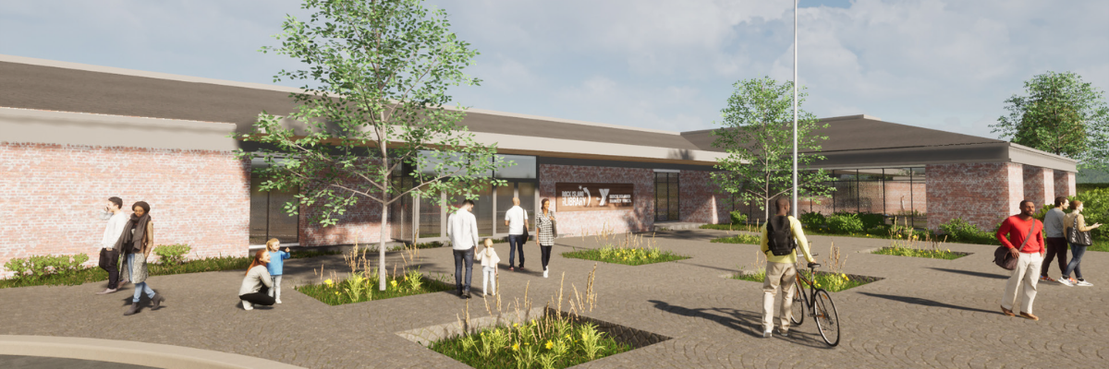
ARPA Completed Projects
Parks/Recreation/Greenspace/Neighborhoods: Watts Midtown Library– ARPA restricted funds

Slide 25
Leveraging ARPA Funds
Public Private Partnerships
Watts – Midtown Library: Rock Island Public Library, Library Foundation, YMCA, City of Rock Island and other funding
Douglas Park: Rock Island Parks & Recreation, Friends of Douglas Park, T-Mobile Grant, City of Rock Island
Hauberg Estate Carriage House: Rock Island Parks & Recreation, Friends of Hauberg, CDBG Funds, City of Rock Island
Leveraging Funds with Grants and Donations
Denkmann Park: ARPA funds and HUD funds
Highland Springs: ARPA funds and donations and financing from First Tee of the Quad Cities
Mel McKay Pickleball Courts: ARPA funds and Open Space Land Acquisition and Development Grant
Downtown Rock Island: ARPA funds, Downtown TIF funds, private donation, state grants
Downtown Parking Structure: ARPA funds and Downtown TIF funds
Augustana College and the City of Rock Island Lead project: State grant
Backup Generators – Water Treatment Plant: Waiting on grant award notification

Slide 26
Thank You!
Discussion & Questions

